Slide 1
PhotoPro
By: Steven Bissell, Kyle Fuson, & David Milostan

Slide 2
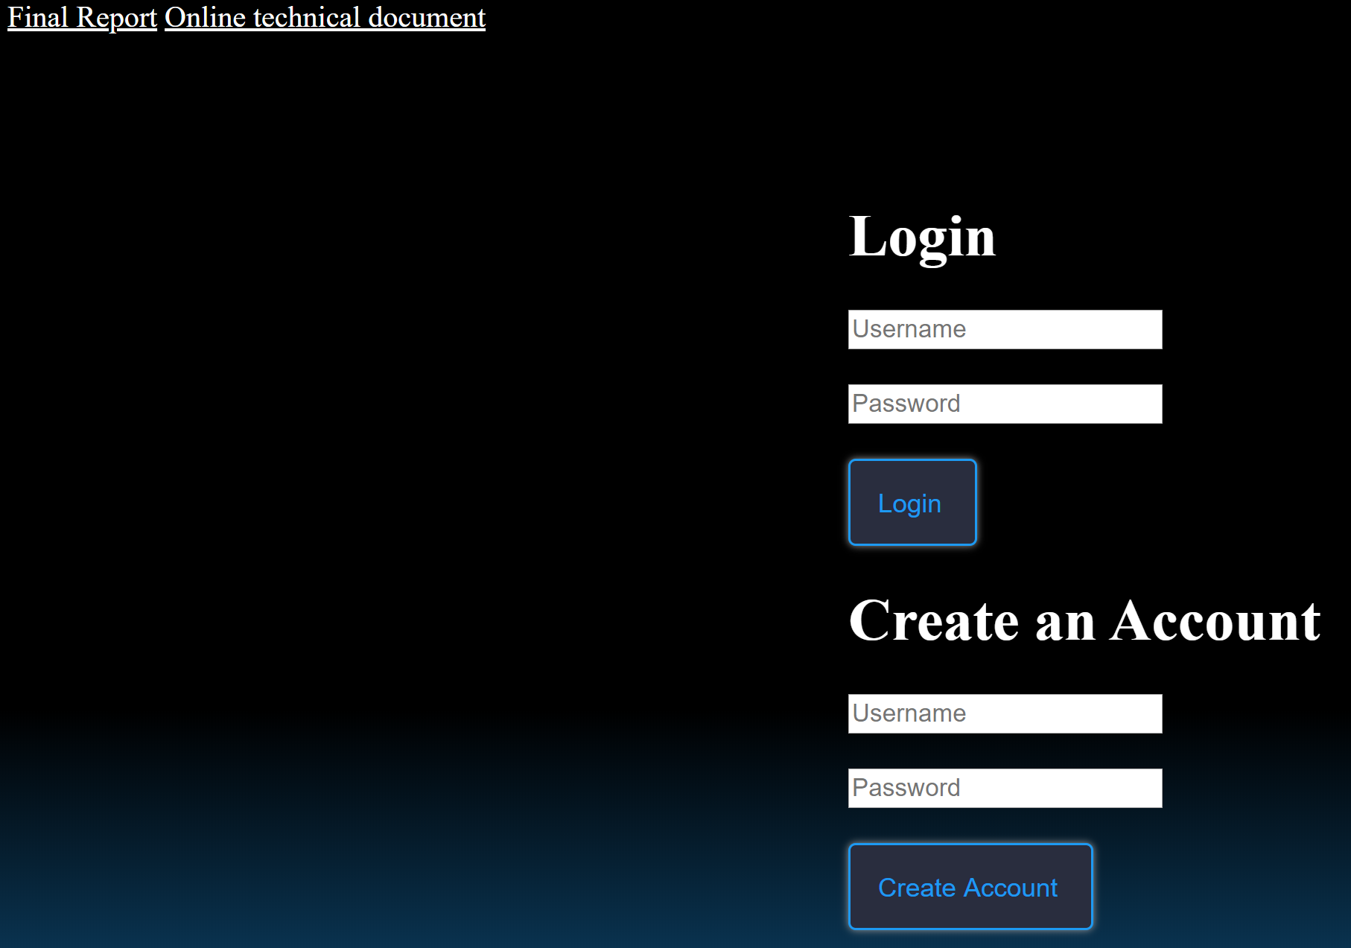
Diagrams of System Design: Login Page

Slide 3
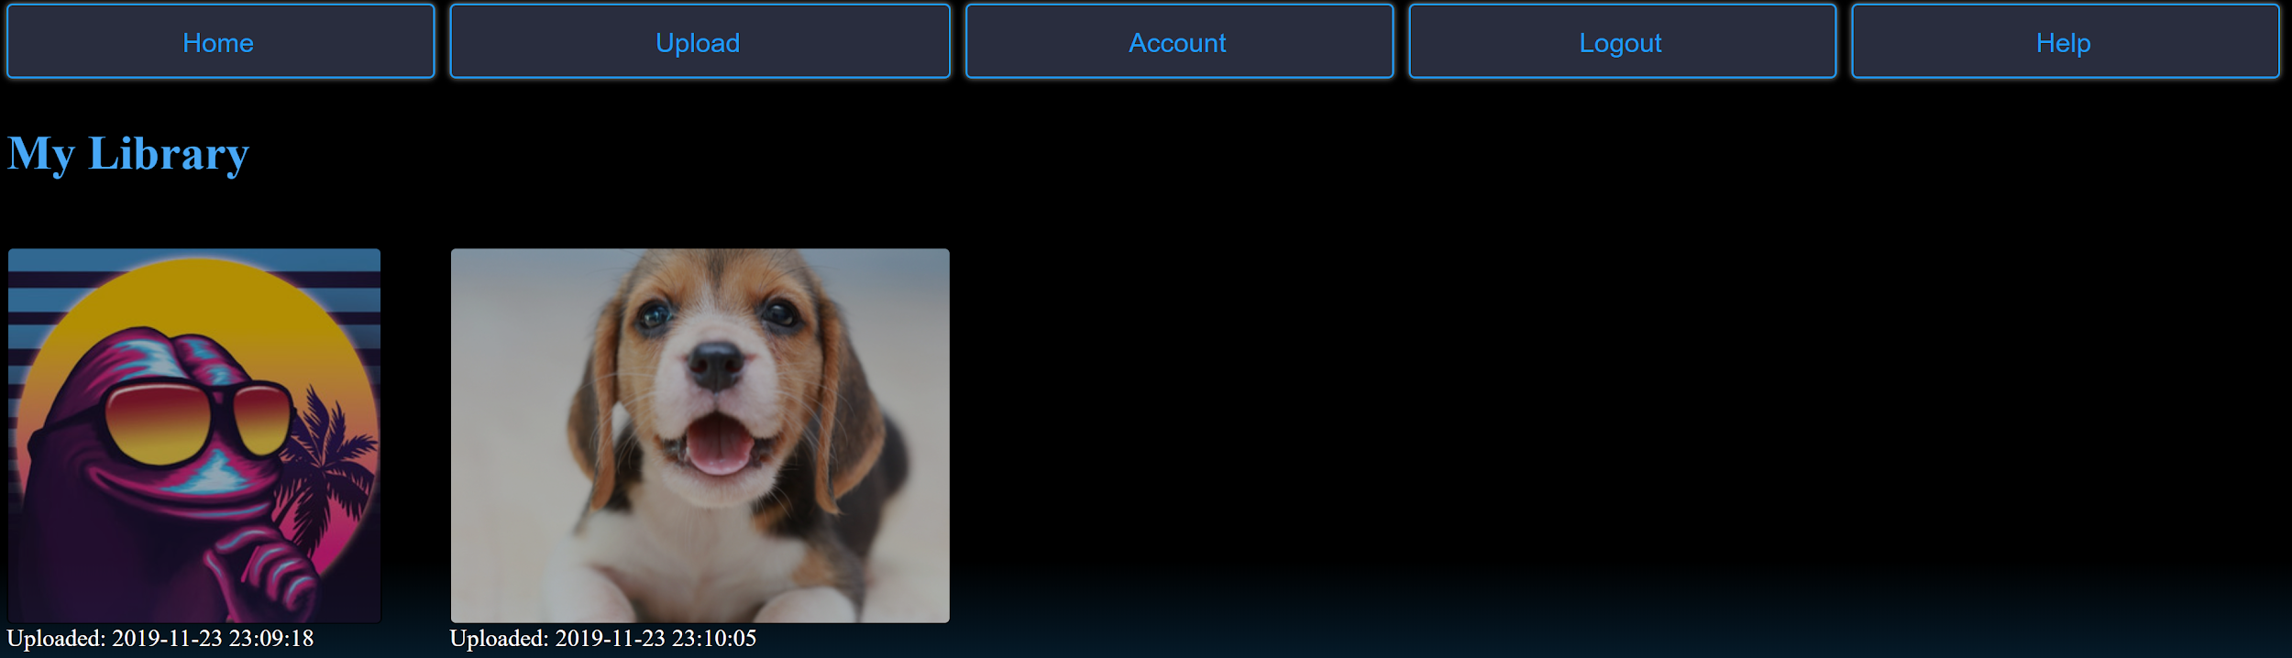
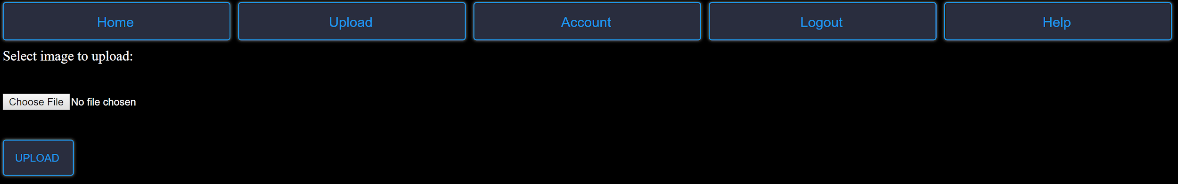
Diagrams of System Design: Home and Upload Page

Slide 4

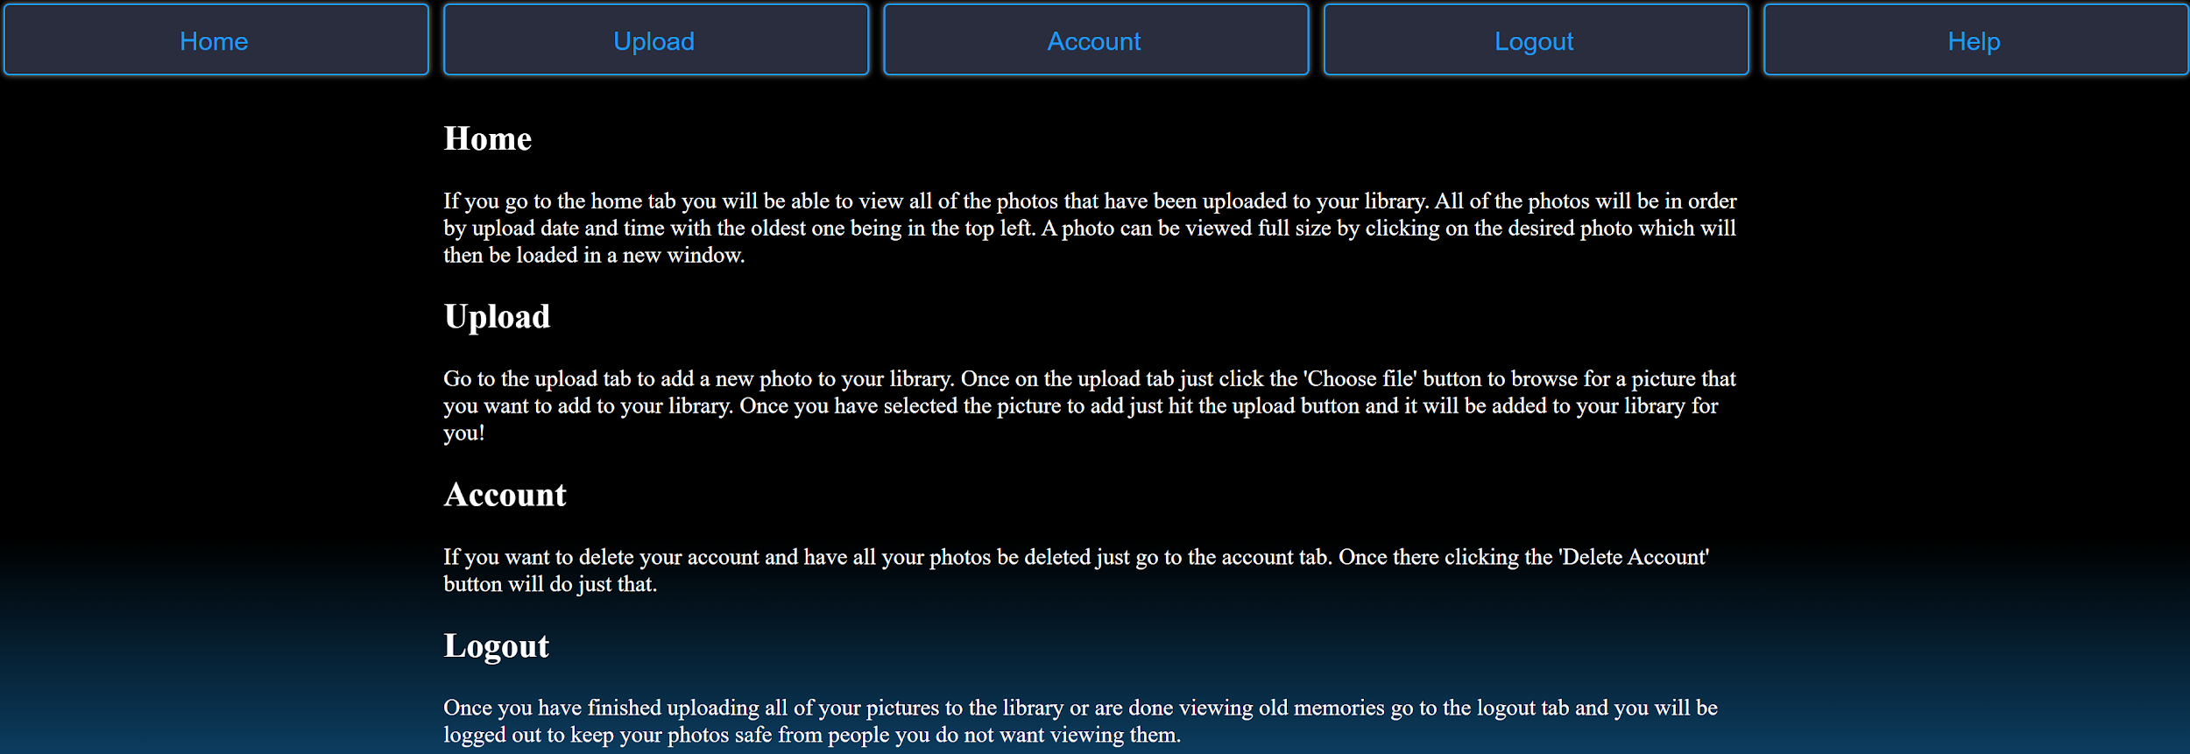
Diagrams of System Design: Account and Help Page

Slide 5
Implementation Tools
HTML
CSS
JavaScript
PHP
SQL

Slide 6
Issues Encountered
Paush removed the temporary directory for the uploads so even though uploading was working when we ran it locally this was not reflected when trying to upload a picture when visiting the site from the pausch server.
Small bug when retrieving photos in the database. It was sending back 3 of each image that a user has uploaded.
Two small bugs that were incorrectly verifying if a username has already been taken and if there username or password was incorrect when attempting to login

